Slide 1

An Introduction into Indoor Air Quality

Slide 2
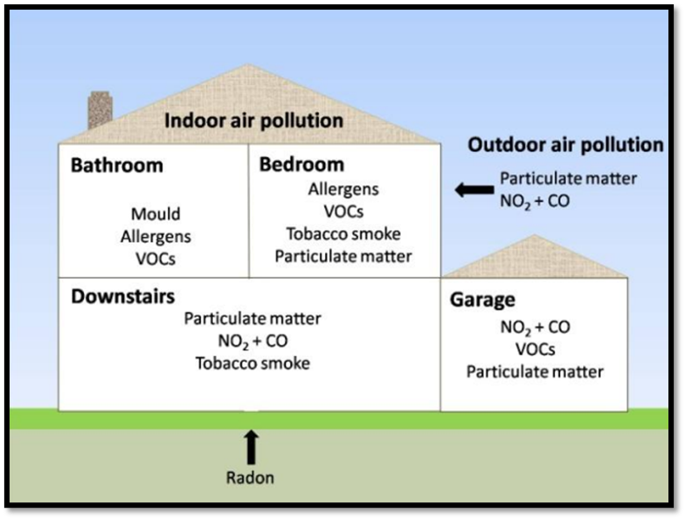
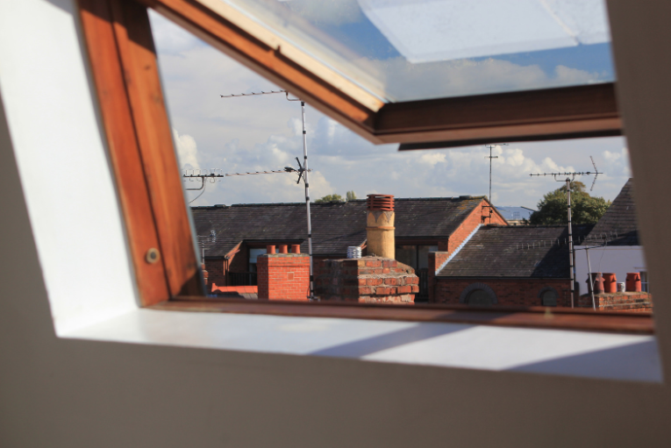
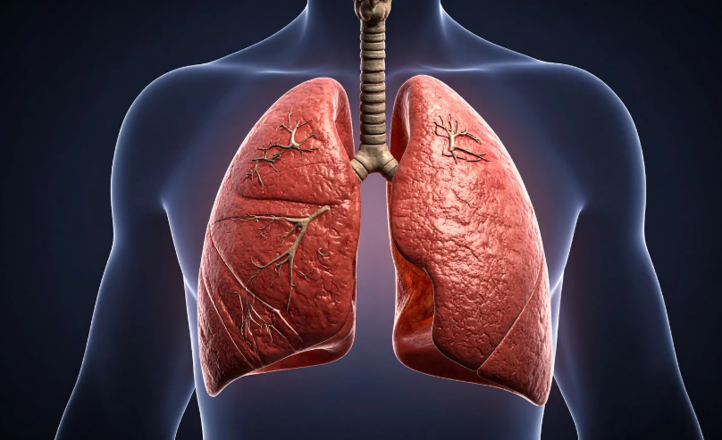
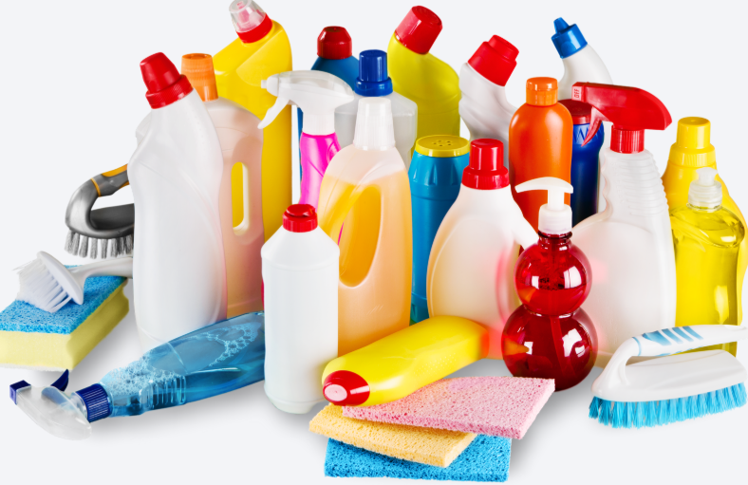

An Introduction into Indoor Air Quality
Aims of the course:
Identify common pollutants and their sources found inside the home.
Describe some of the impacts that pollutants in the home can have on human health.
Describe practical ways to reduce the levels of pollutants found in the home.

Slide 3
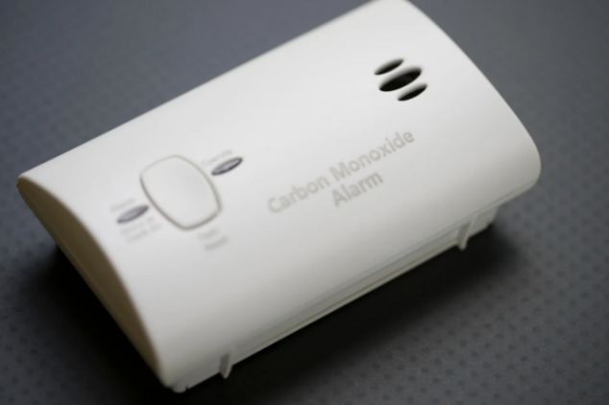
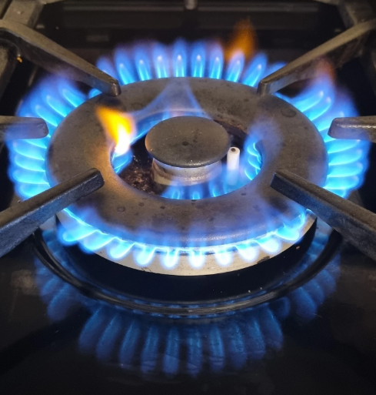
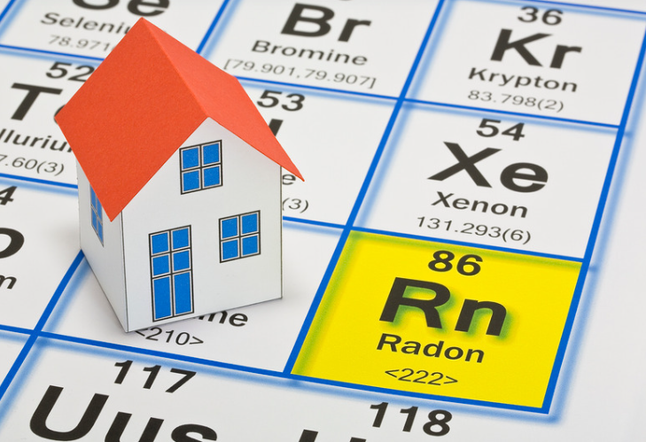

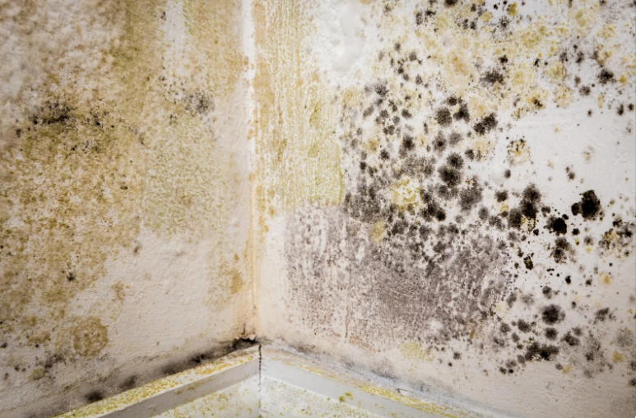
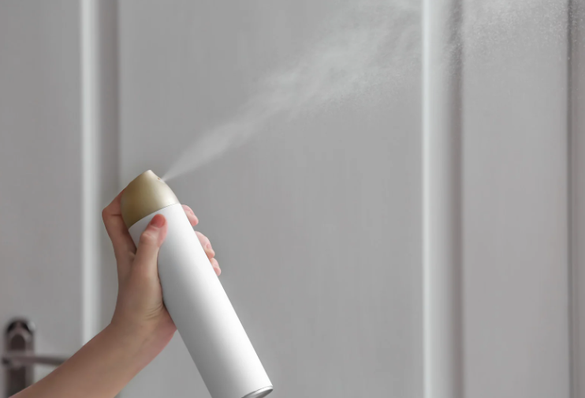
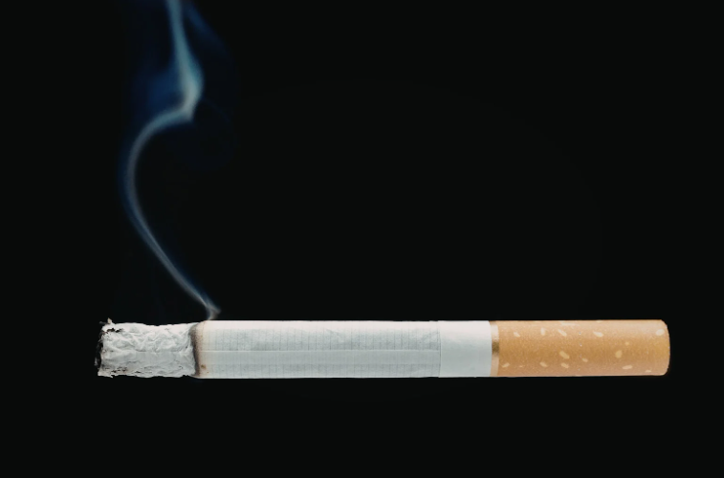
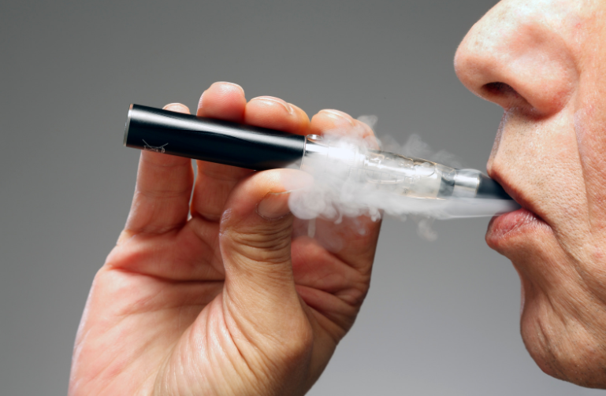
Introduction to Indoor Air Quality
There are a range common pollutants that can be found in the home these include:
Particulate matter (PM)
Nitrogen oxides (NOx)
Carbon monoxide (CO)
Radon
Tobacco Smoke and Vaping
Mould
Volatile organic compounds (VOC)

Slide 4
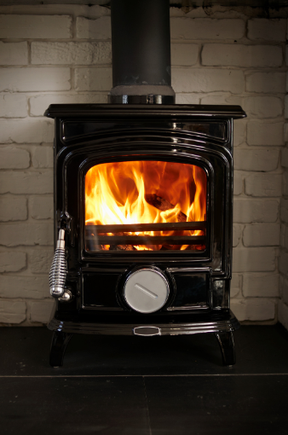
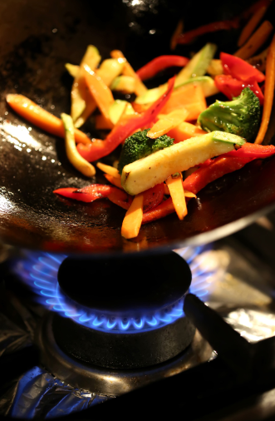
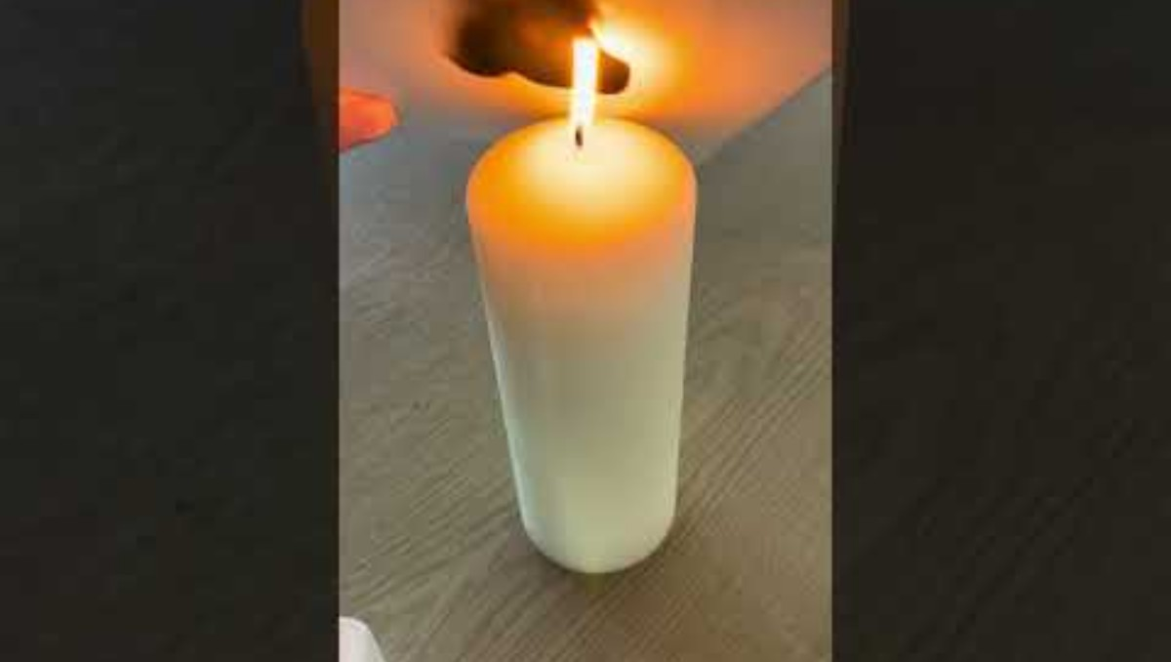
Particulate Matter (PM)
Particulate matter (PM) is the term used for microscopic solid particles found in the air.
The video shows the particulate matter (soot) being formed from a candle. Soot is formed when a fuel burns when there isn’t enough oxygen present.
Particulate Matter can originate from a range of sources inside the home; however most particulate matter that is released, in UK homes, is produced through the processes of burning fuels and cooking.

Slide 5
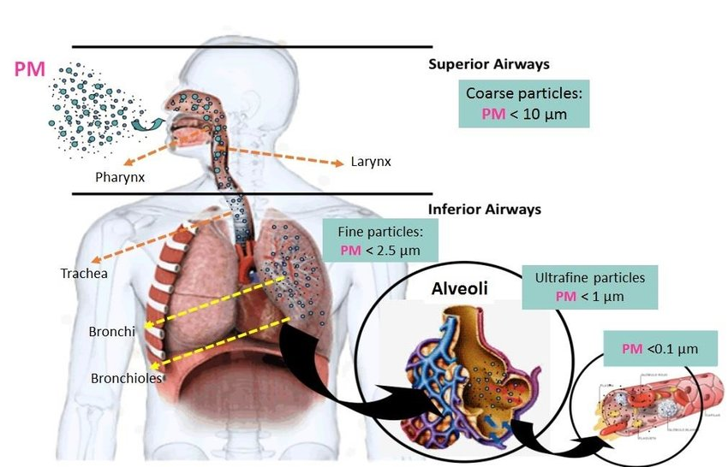
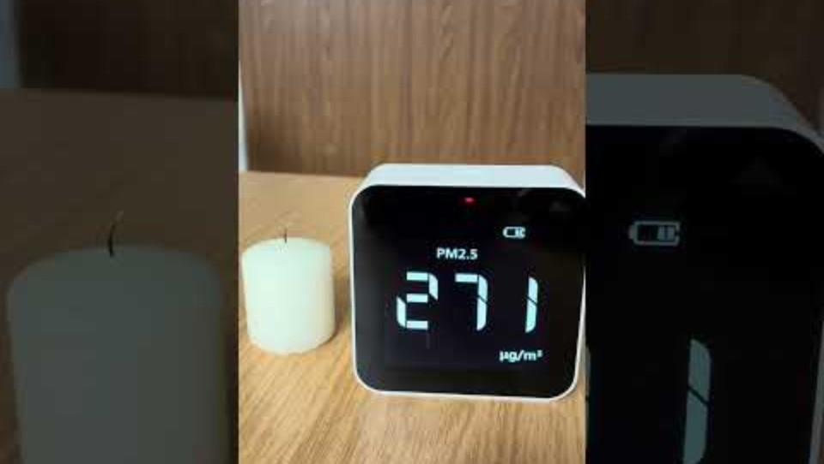
Particulate Matter (PM)
The smaller the size of the particulate matter, the greater the danger to health.
This is because smaller particles can move deeper into the respiratory system and can pass from the lungs into the blood and travel to other organs in the body.
The video shows the levels of Particulate Matter when a candle is blown out.
Respiratory tract and particulate matter (PM) size classification. (Modified from: https://www.intechopen.com).

Slide 6

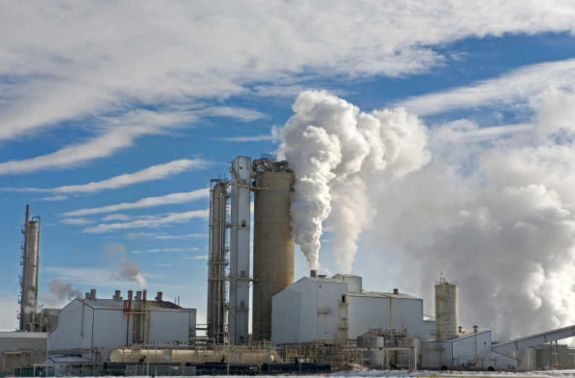
Particulate Matter (PM)
Particulate matter can also infiltrate into the home, through open windows and doors from the air outside. Sources of these include car exhaust fumes, the wearing of car tyres and brakes, industrial emissions, and domestic wood burners.
Households should ventilate houses by opening windows and doors, when there is less traffic on nearby roads.

Slide 7
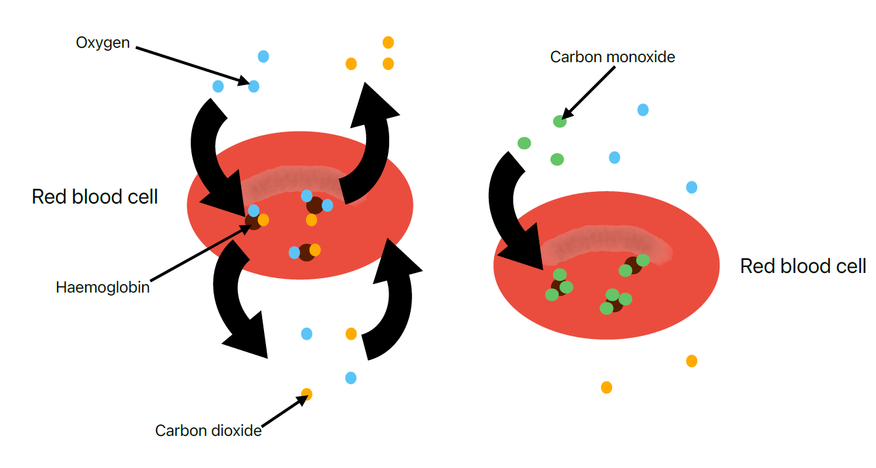
Carbon Monoxide(CO)
Carbon monoxide is an odourless, colourless, poisonous gas.
It is formed when a fuel is burnt with a lack of oxygen.
When carbon monoxide is inhaled it can pass into the blood stream, where it strongly binds to the haemoglobin in red blood cells.
Carbon monoxide prevents oxygen from binding to the haemoglobin and prevents oxygen from being transported to the cells around the body.
This results in cells being depleted of oxygen, which they need to carry out chemical reactions to release energy.
Diagram showing carbon monoxide blocking haemoglobin in red blood cells which transport oxygen and carbon monoxide.

Slide 8
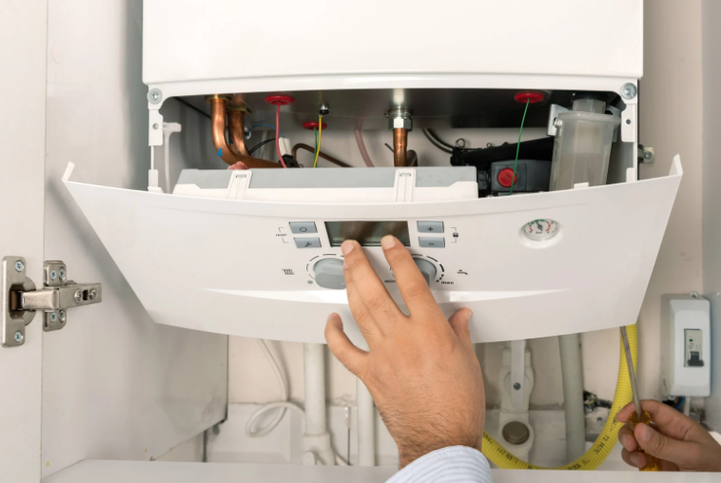
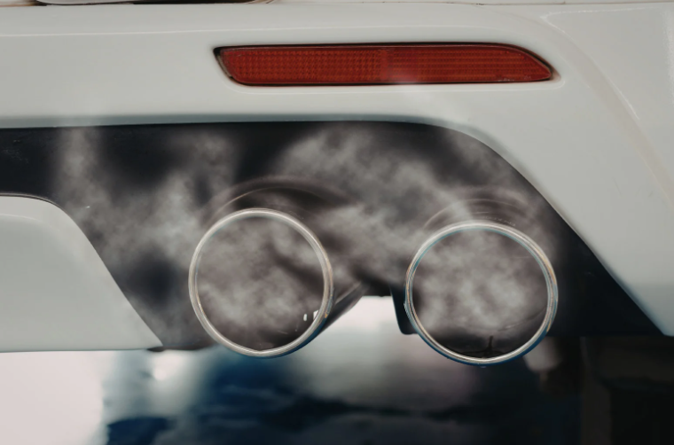
Sources of Carbon Monoxide
Follow the link below to watch the video clip which explains carbon monoxide poisoning.
https://www.britannica.com/video/carbon-monoxide-poisoning/-208034
Health implications of Carbon Monoxide (CO)
Lower levels of exposure can cause
Headaches
Dizziness
Nausea
Vomiting
Feeling weak
Confusion
Shortness of breath
Chest pains
Higher levels of exposure can result in a person collapsing and death within a few minutes.
Car Exhaust Fumes in unventilated garages
The burning of solid fuel in the home, such as log burners.
Faulty, not well maintained or improperly installed cooking and heating appliances, such as gas boilers and cookers.
From the 2024 Office of National Statistics data, there were 60 recorded deaths attributed to accidental carbon monoxide poisoning.
Cigarette smoke

Slide 9
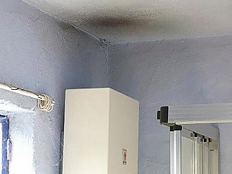
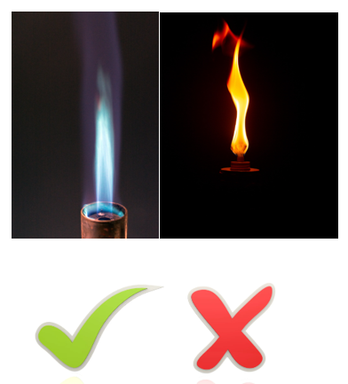
Possible signs of the presence of carbon monoxide
If multiple occupants of the building have common symptoms.
If the symptoms improve if you go outside of the building.
If the symptoms improve if all gas appliances in the building are turned off.
What to do if you suspect carbon monoxide poisoning:
Stop using any appliances that maybe the source of carbon monoxide, this could be gas boilers, cookers, or gas fires or heaters.
Go outside.
Seek medical advice as soon as possible. Call 111 if you have any symptoms. If the symptoms of more acute call 999 immediately.
Orange flames on an appliance and wood burners.
The pilot light on a gas boiler isn’t consistent or is weak.
There is black soot around gas powered appliances.
You have a working carbon monoxide detector that is making an alarm sound. Make sure that the alarm is built to the British Standards (EN 50291).

Slide 10
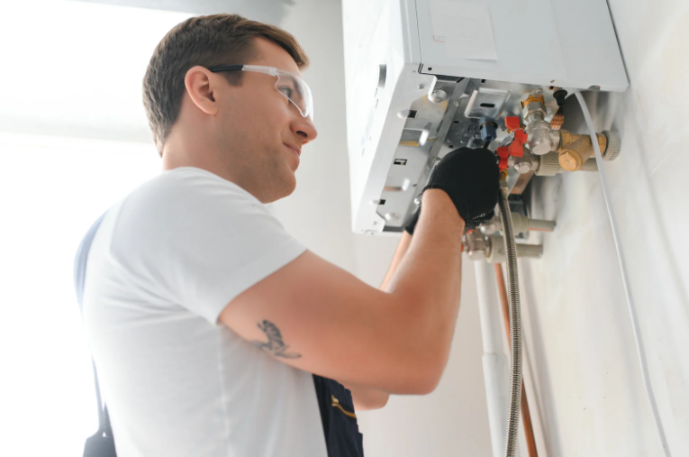
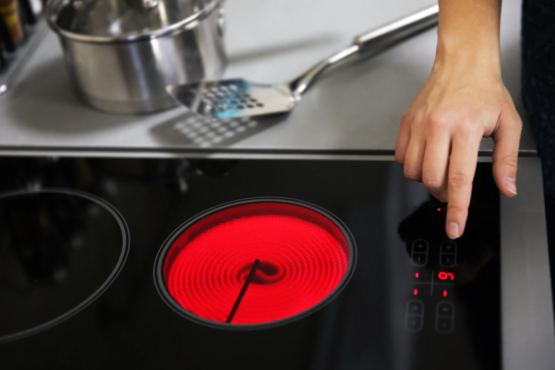
How to reduce the chances of Carbon monoxide poisoning
You have a working carbon monoxide detector that is makes an alarm sound. Make sure that the alarm is built to the British Standards (EN 50291). Regularly test that it is working.
Upgrade gas appliances for electrical appliances for heating and cooking.
Minimise the burning of solid fuels in the home, such as wood burners.
Regularly service gas appliances such as gas boilers, gas cookers and fires.
Regularly ventilate homes by opening windows and doors.

Slide 11
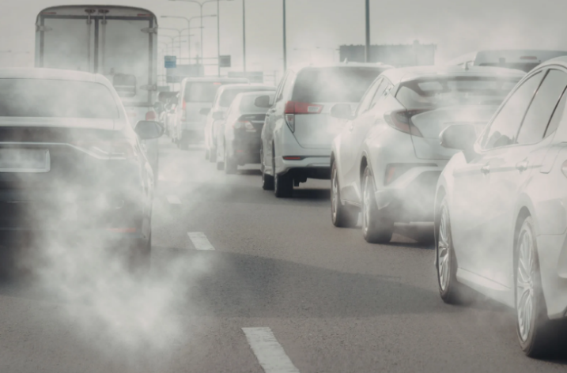
Nitrogen Oxides (NO_{X})
Nitrogen oxides (NOx) are formed when nitrogen and oxygen from the air undergo a chemical reaction at high temperatures.
Nitrogen oxides are also produced in car engines, through the same process. Households living near busy roads can have much higher levels of nitrogen oxides present, which can enter the home through open windows and doors.
Households should ventilate houses by opening windows and doors, when there is less traffic on nearby roads.

Slide 12

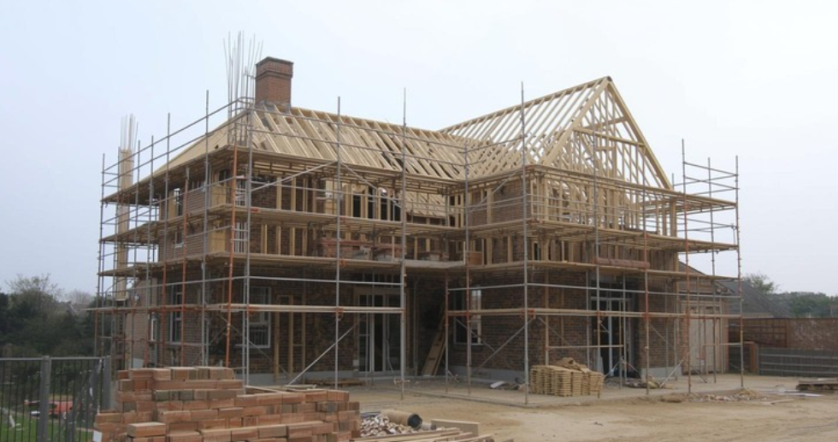
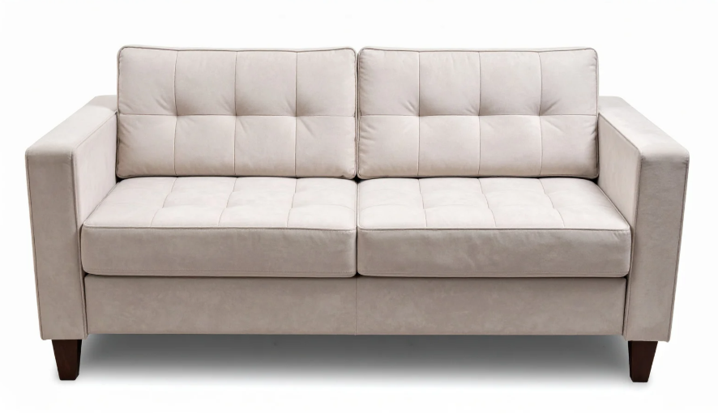

Volatile Organic Compounds(VOC)
Volatile organic compounds (VOC) are chemicals that easily evaporate to become gases in the air at room temperature.
There are a range of sources of VOC in the home, which include:
Aerosols
Cleaning Products
Candles
Furniture
Paints
Adhesives
Cooking
Building Materials
Mould

Slide 13
Tobacco Smoke and Vaping
Tobacco Smoke consists of more than 5,000 chemical compounds including nicotine, carbon monoxide, particulate matter and volatile organic compounds.
At least 70 of the chemicals are classified as carcinogens (Cancer causing).
Vapes, work by heating up a liquid that becomes a vapour that people can breathe in.
They usually contain nicotine, which is the addictive chemical in cigarettes, however they do not contain tobacco, which is the harmful part of cigarettes that causes cancer.

Slide 14
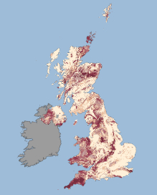
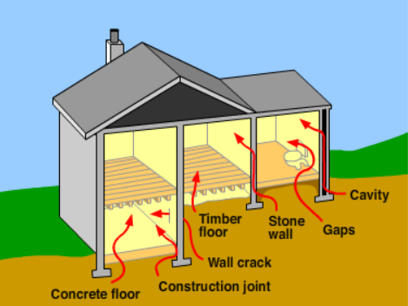
Radon Gas
Radon is a colourless, odourless, radioactive gas.
Radon is a naturally occurring radioactive gas released from the decay of uranium within rocks and soil.
Radon can enter a home from the ground through gaps and cracks in floors in the building. Unventilated basement rooms can have higher levels of radon compared to well-ventilated rooms.
Figure 7 UK Gov Radon Map
https://www.ukradon.org/information/ukmaps
Use the link to find the radon levels in your area.

Slide 15
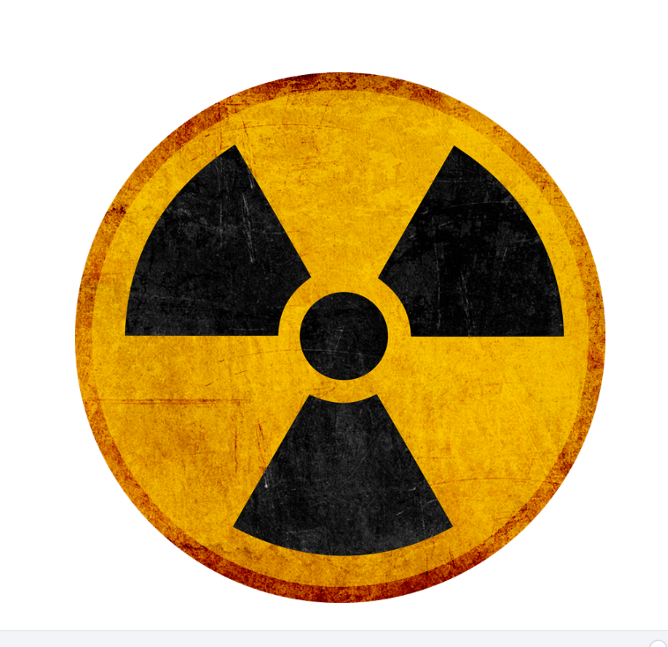
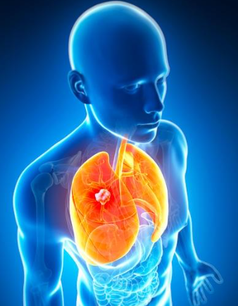
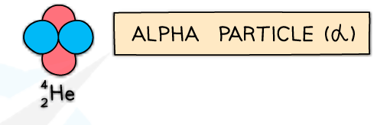
Radon Gas
Radon decays into other radioactive elements, which can be inhaled and enter our lungs, and release alpha particles.
Alpha particles are absorbed by nearby tissue; they are highly energetic and cause damage to cells and can lead to cancer.
Radon gas in the home leads to about 1000 deaths from lung cancer each year.

Slide 16

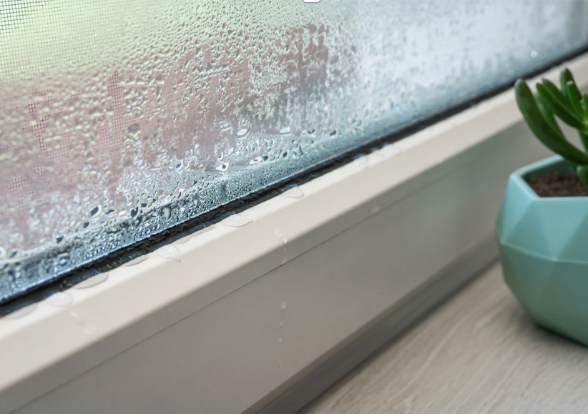
Mould Formation
Damp and humid conditions in the home can lead to mould growths on places such as walls, carpets and furniture.
The mould can release a range of pollutants including fungal spores, allergens, volatile organic compounds (VOC) and toxins.
Listen to the Podcast which outlines some of the issues and with damp, mould and condensation in a home, with top tips to prevent mould forming.

Slide 17
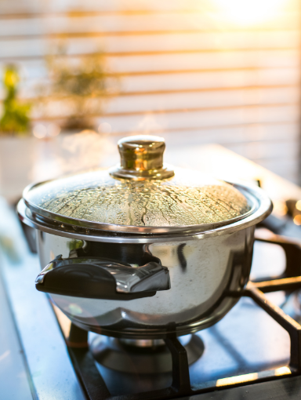
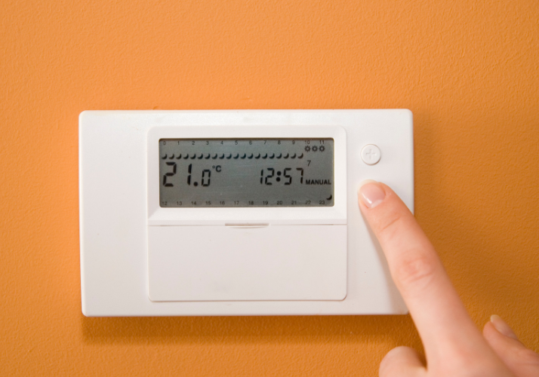
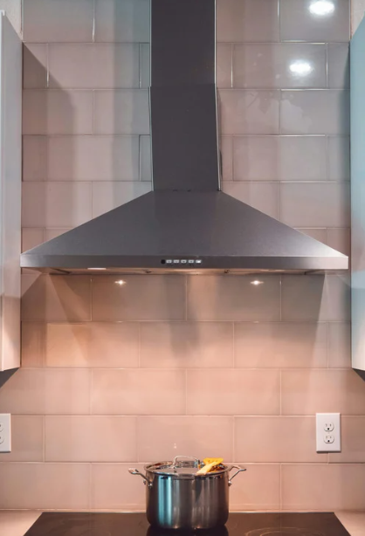
Mould Formation
Mould forms in damp conditions in the home, the best way to reduce mould growth is to reduce the amount of moisture that is present in the air. Households could reduce the amount of moisture in the home by:
Regularly ventilating the home by opening windows and doors, this will allow moisture to escape.
Place lids on pans, use extract fans and/or open windows when cooking.
Keeping your home warm, between 18-21℃, this will help prevent condensation forming.

Slide 18


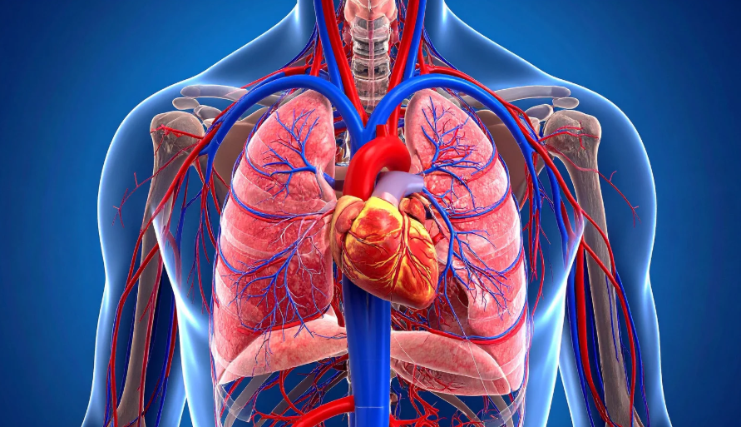

Vulnerable Groups
Young Children are more vulnerable to the effects of particulate matter and nitrogen oxides because of having less developed organs, especially their lungs.
Households living in fuel poverty are more likely to have homes with poor indoor air quality.
People with pre-existing health conditions such as asthma and cardiovascular diseases are more prone to the effects of poor indoor air quality.
Elderly People who may have weakened immune systems maybe more susceptible to health impacts caused by damp, mould and condensation.
Pregnant people and their unborn babies – Particulate matter exposure is linked to low birth weight and premature births.

Slide 19
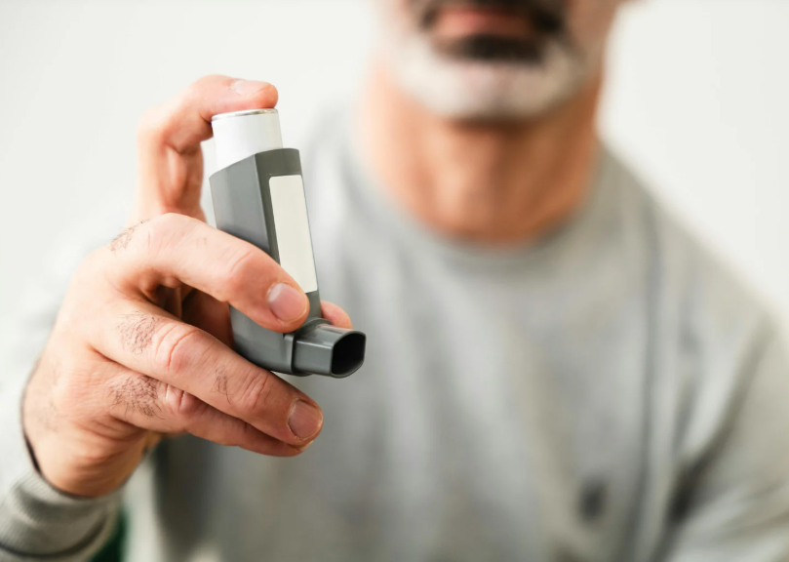
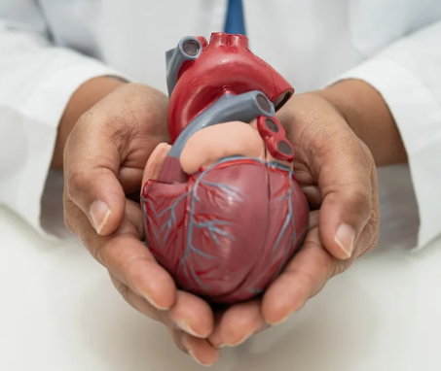
Health Impacts
There are a wide range of health impacts that indoor air pollutants can cause. Some common health impacts include:
Cardiovascular diseases.
Irritation of the airways.
Triggering and causing new asthma cases.
Coughing, wheezing, and difficulty breathing.

Slide 20
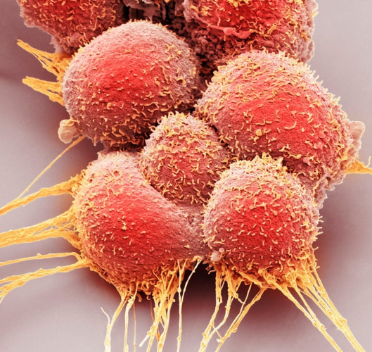
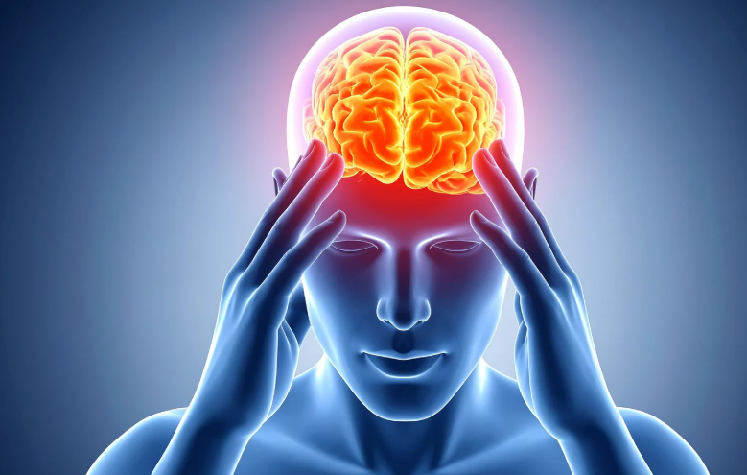

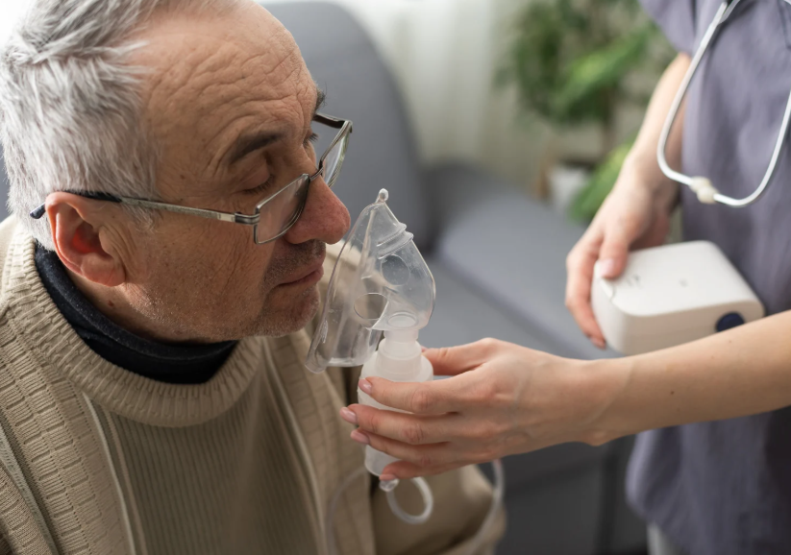
Health Impacts
There are a wide range of health impacts that indoor air pollutants can cause. Other impacts include:
Tobacco smoke, volatile organic compounds and particulate matter can increase the chances of developing some cancers.
Particulate matter and nitrogen oxides can result in cognitive decline.
Volatile organic compounds and bioaerosols from moulds, pet dander, and pollen can cause result in allergies.
Tobacco smoke, particulate matter, and bioaerosols from mould can result in Chronic Obstructive Pulmonary Disease (COPD).

Slide 21

How to improve indoor Air Quality
1. Ventilate your home by opening windows, pollutants and moisture can escape the home.
2. Reduce the burning of solid fuels, gas, candles and incense sticks. This reduces particulate matter forming.
3. Smoke cigarettes and vape outside of the home, with the doors and windows closed.

Slide 22
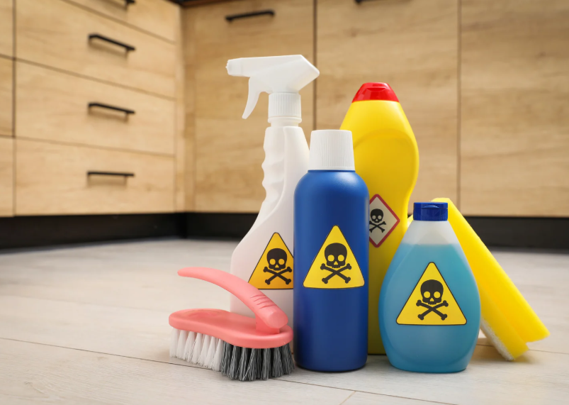
How to improve indoor Air Quality
4. Reduce the use of harsh chemicals and chemicals with fragrances in the home.
5. Prevent damp conditions forming in the home to reduce the chances of mould forming.
6. Minimise the levels of pollutants that are formed during cooking by placing lids on pans and using an extract fan.

